Slide 1
My Weather App
Tendai Vashiko
ST10441728
Link to my READMEFILE
https://advtechonline-my.sharepoint.com/:w:/g/personal/st10441728_imconnect_edu_za/EX_pLqe4hQdPgEajJuiBGK4BXuT8QfNwtfe_qHIcL4sdjg?e=SWaNka

Slide 2
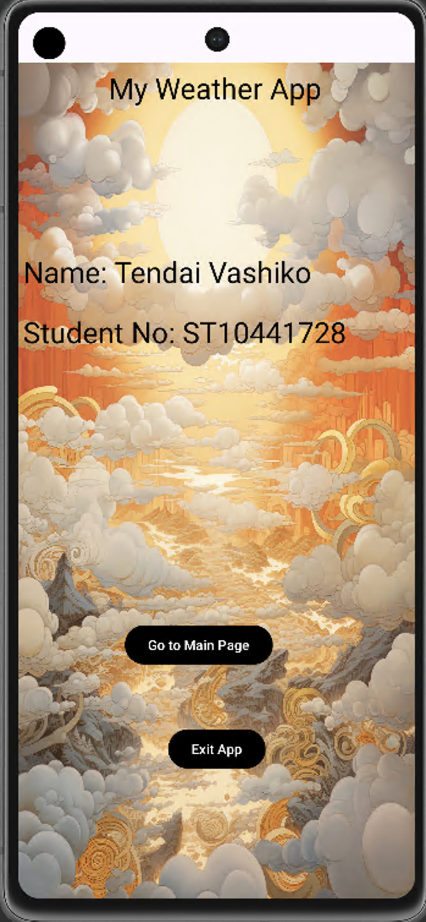
Splash screen
This is the splash screen of my weather app. It displays name and student number. To engage the user I have used a colorful background with clouds in theme with the use of my app.
The Go To Main Page button takes the user into the main screen of the app. When clicked the exit button takes the user totally out of the app.

Slide 3
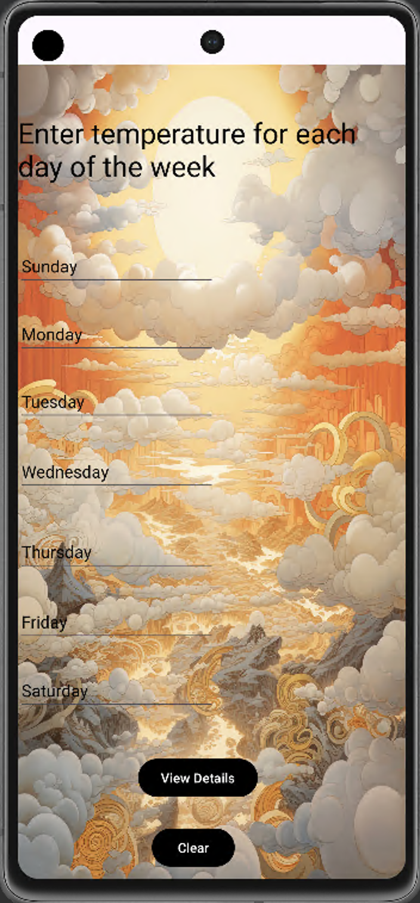
Main Screen
On the main screen seven text boxes(edittext) with each day of the week as a hint are displayed. For the mere fact that the user doesn’t have to delete the days of the week to enter the temperature because they are set as hints makes it easier for the user to utilize the app. After recording the temperatures if the user wants to see all the temperatures for the whole week they have to click the button that says View Details. However if the user wants to clear all the data they have put in they can simply click the Clear button.

Slide 4
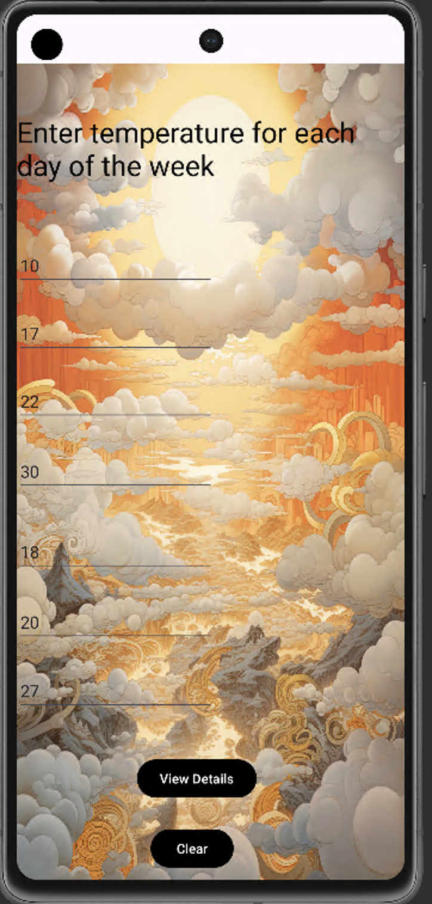
Main screen
Once the user enters the temperatures, this is how they are displayed before clicking the View Details button or the clear Button. The app was set up in such a way that the user can only enter numbers not text.

Slide 5
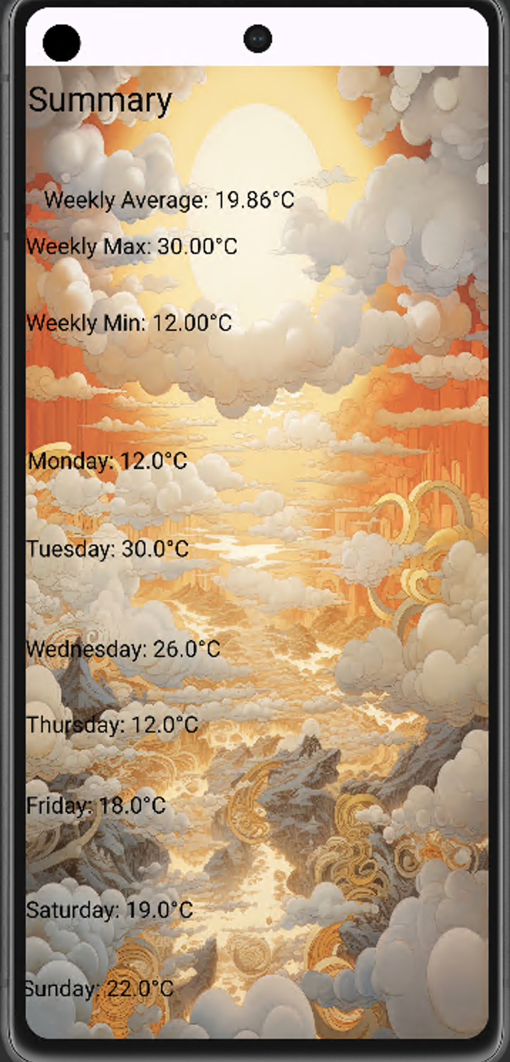
Detailed View Screen
The detailed view screen of my app shows all the information recorded throughout the week. Figure No4 is an example of how the temperatures will be displayed and they are all in degrees celsius. This screen also shows the average , the maximum and the minimum weekly temperature.

Slide 6
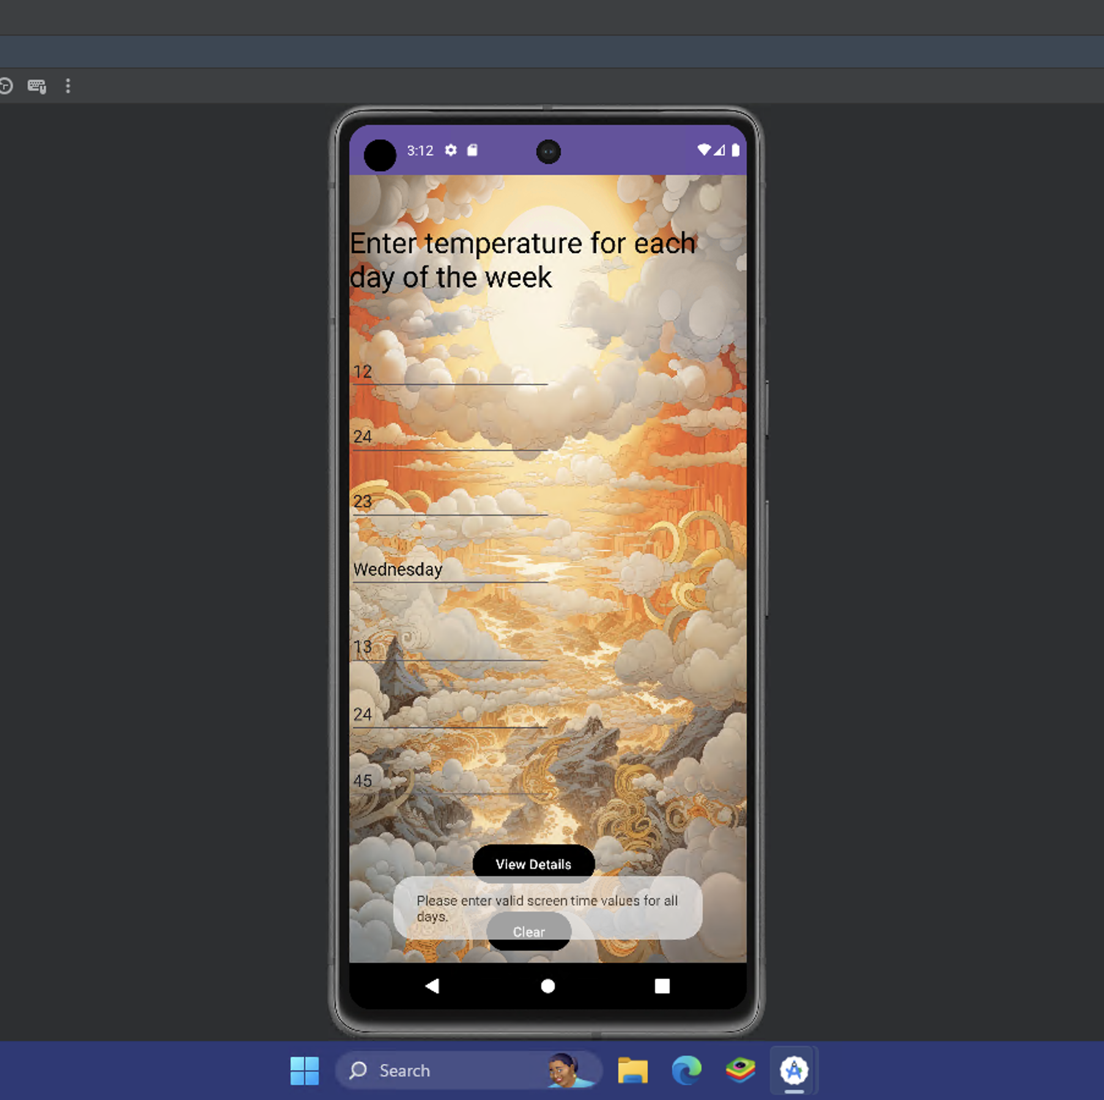
Error handling
When a user does not enter all the numbers or when nothing is entered at all, an error message will be displayed

Slide 7
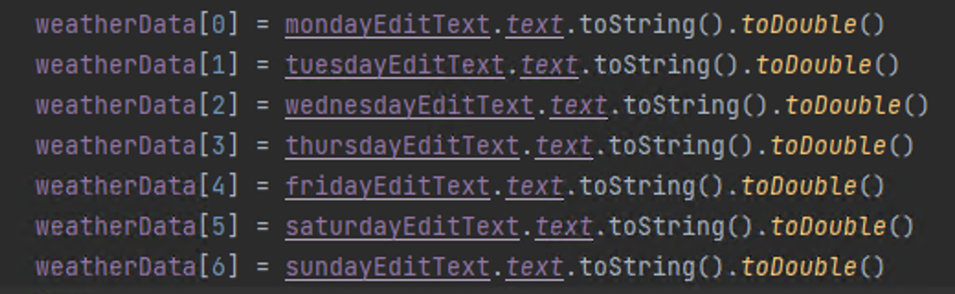
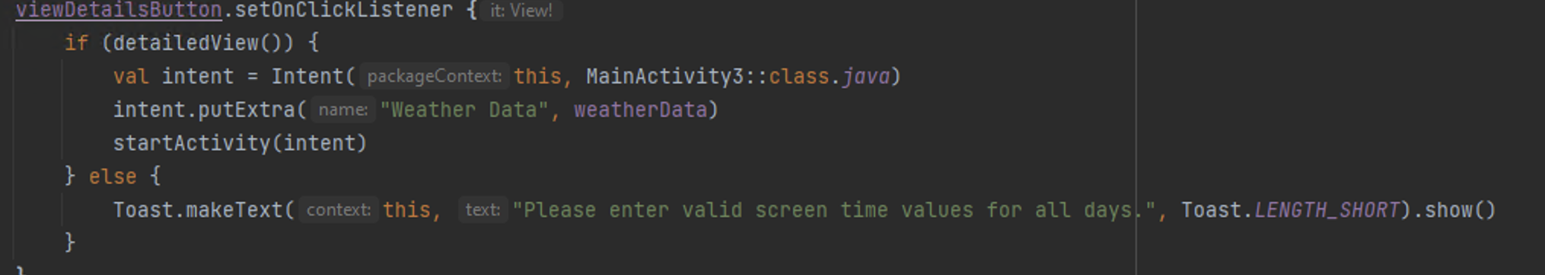
codes
I used weatherData array to manage the weekly weather.
I used if statements to set the conditions for the user input

